Slide 1
AWS Forecast: DeepAR Predictor
Time-series
4th September 2019
20 Bridge Street

Slide 2
Agenda
Introduction
Why time-series and how are they different?
Classical (Statistical) and Modern time-series methods
AWS Forecast: Modern Time-series
AWS Predictor: DeepAR
Demo on DeepAR

Slide 3
Why are time-series methods important?
1
Time series are everywhere!
2
Most methods were designed for use on cross-sectional data
3
We can drive better business outcomes through the use of time-series methods
Notes:
Lets first start with why time-series series methods are important.
The first reasons is that time series problems are everywhere; they appear in financial data, customer behavior data, property data and engineering problems. In fact, in our experience, we have that around 70% of our consulting projects have some time-series component or consideration that needs to be incorporated into the solution.
The second reason is that most methods, especially the standard ones inside statistics and machine learning are built for cross-sectional problems. If you haven’t heard of this terminology before, cross sectional problems are where we take many observations at a point in time from many individuals.

Slide 4
How are time series problems different?
Different states in a time series can make the problem harder to model.
There could be multiple forecasting horizons; short, medium, long term.
Typically you care about the prediction as well as the confidence in the prediction.
Model testing and validation must be conducted in a different way to avoid data leakage and select the best model.
Notes:
Time–series data is a chronological sequence of observations on a particular variable.

Slide 5
What are desirable properties of time series methods?
Multi-step multivariate prediction
Handles non-linearities/interactions
Shares information across time-series
Works with high dimensional data
Leverages meta-information
Models autocorrelation structure implicitly
Works on sparse data
Minimal feature pre-processing and engineering
Notes:
Time–series data is a chronological sequence of observations on a particular variable.

Slide 6
Traditional Models
Classic vs Modern Models: Benefit & Challenges
ML Models
Autoregressive ARIMA. ETS
Random Forest. Prophet. LSTM. AWS Forecast
Autoregressive models are remarkably flexible at handling a wide range of different time series patterns, but … How about ability to learn and generalized from similar series (to learn more complex models without overfitting)
Based on neural networks with a modified architecture. Implicitly models interactions, non-linearities as well as time-series features. LSTM’s (vs RNN) do a better job of modelling long term time dependencies.
Benefits | Challenges
Interpretable Implicitly models auto-correlation structure Works well when there is little exogenous information | Doesn’t share information across time-series Forecasting a large number of individual or grouped time-series Struggles with sparsity and special events
Benefits | Challenges
Shares information across time series Uses meta-information Models non-linearities as well as interactions Some works with missing values | Struggles if little meta-information Requires larger volumes of data Larger amounts of data preprocessing needed. Tend to average predictions too much across time series
Notes:
Exponential smoothing (ETS methods)
Classical methods typically work through:
Decomposition of time-series into each of its components
Find average historical affects for each component
Aggregate average historical affects and forecast one step ahead
Modern time series methods follow the same patterns as traditional machine learning approaches with 3 major modifications:
Time-series features are manually created by the user (time-series feature engineering) if the algorithm cannot implicitly model them.
Specific Machine learning methods are applied that give us the point estimate as well as the distribution.
Traditional time series validation (not random sampling) is used with specific metrics.

Slide 7
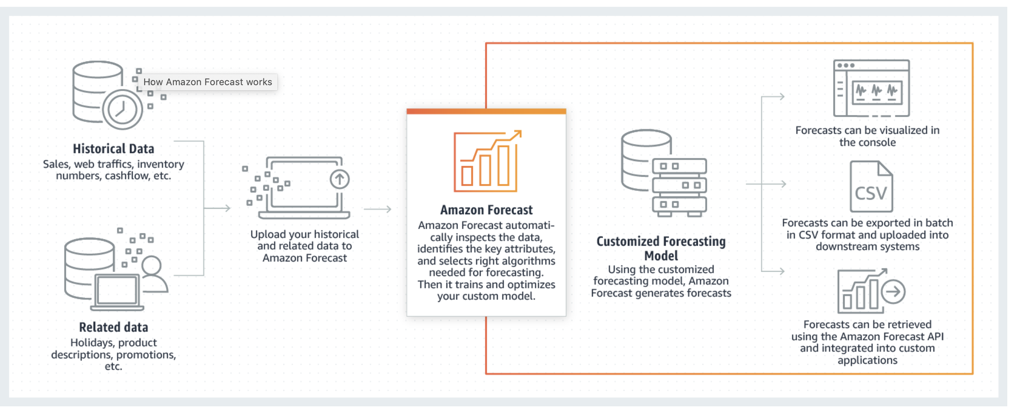
AWS Forecast
Amazon Forecast is a fully managed service that uses machine learning to deliver highly accurate forecasts.
 | Statistical | Machine Learning
Volume of data | Works well with little information | Needs data from several series or several features
Can share meta-information | No (ARIMAX exception) | Yes
Can handle sparse data | No | Yes
Can handle non-linearities/interactions | No or only explicitly | Yes
Can leverage shared information between time-series | No (VAR exception) | Yes, but tends to average too much
Can work with high dimensional data | Limited | Yes
Benefits
Use cases
50% more accurate forecasts with machine learning
Reduce forecasting time from months to hours
Product Demand Planning
Retail product demand
Supply chain demand
Operational metrics
Business metrics
Financial planning
Resource planning
Notes:
Developers with no machine learning expertise can use the Amazon Forecast APIs, AWS Command Line Interface (AWS CLI), or Amazon Forecast console to import training data into one or more Amazon Forecast datasets, train predictors, and generate forecasts.

Slide 8
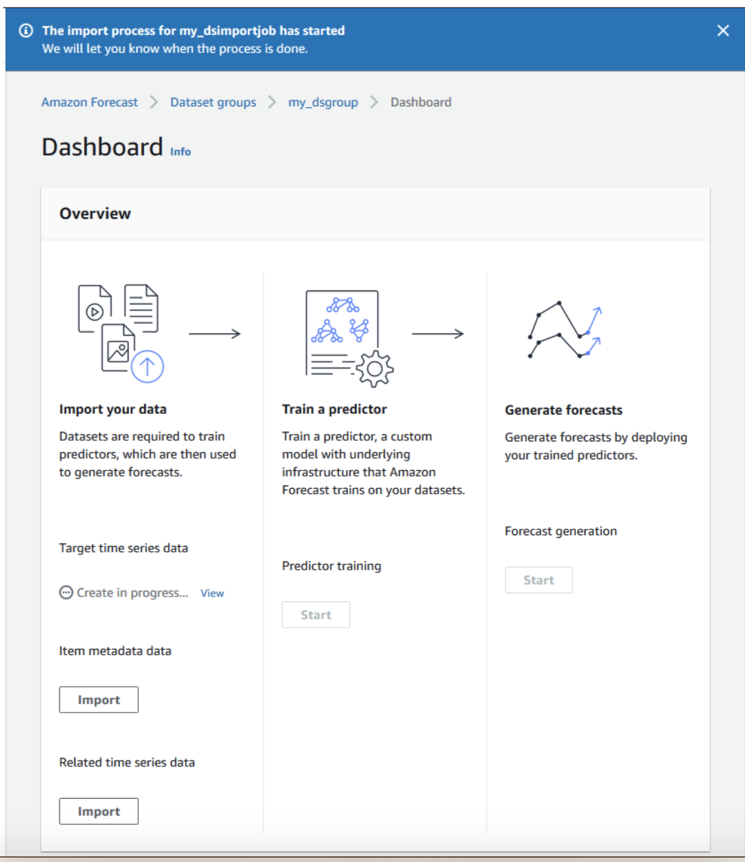
AWS Forecast
How This Works?
Setting Up:
Sign Up for AWS
Set Up the AWSCLI
Set Up Permissions for Amazon Forecast
Datasets and Dataset Groups
Predictor:
Predictors
Autoregressive Integrated Moving Average(ARIMA)
arn:aws:forecast:::algorithm/ARIMA
DeepAR
arn:aws:forecast:::algorithm/Deep_AR
Prophet
arn:aws:forecast:::algorithm/Prophet
Forecasts
Notes:
When creating forecasting projects in Amazon Forecast, you work with the following resources:
Before using Amazon Forecast to evaluate or forecast time-series data, create an AWS account, configure access permissions, and set up the AWS Command Line Interface (AWS CLI).

Slide 9
AWS Predictor: DeepAr
DeepAR is a forecasting model based on autoregressive RNNs, which learns a global model from historical data of all time series in all datasets
DeepAr is
Multi-step multivariate time series:
Given observed values of a series i for
t time-steps, estimating probability distribution
of the next T steps
Pros | Cons
Shares information across groups of time series Models non-linearities as well as interactions Minimal manual feature engineering Ability to incorporate a wide range of likelihood models, including probabilistic forecasts in the form of Monte Carlo samples | Struggles if little meta-information Requires larger volumes of data Tend to average predictions too much across time series
Notes:
Autoregression is a time series model that uses observations from previous time steps as input to a regression equation to predict the value at the next time step.
A recurrent neural network (RNN) is a class of artificial neural networks where connections between nodes form a directed graph along a temporal sequence

Slide 10
Best Practices for using the DeepAR Algorithm
Input/Output interface:
Supports two data channels (Train and Test for evaluation)
Format: JSON, gzip, and Parquet
Best practice:
Except for when splitting your dataset for train and test, always provide the entire time series. Why: the lagged value features
Test points should start immediately after the last time point of training
Avoid using very large values (>400) for the prediction length because it makes the model slow and less accurate. Solution: consider aggregating your data at a higher frequency.
ARIMA or ETS, might provide more accurate results on on a single time series. The DeepAR algorithm starts to outperform the standard methods when your dataset contains hundreds of related time series.
Train: on both GPU and CPU instances. Inference: only CPU
Use small number for context_length, prediction_length, num_cells, num_layers, or mini_batch_size, in case of small instances

Slide 11
DeepAR: Demo
SageMaker/DeepAR demo on electricity dataset
Notes:
https://github.com/awslabs/amazon-sagemaker-examples/blob/master/introduction_to_amazon_algorithms/deepar_electricity/DeepAR-Electricity.ipynb

Slide 12
References
https://docs.aws.amazon.com/forecast/latest/dg/forecast.dg.pdf
https://aws.amazon.com/blogs/aws/amazon-forecast-time-series-forecasting-made-easy/
https://docs.aws.amazon.com/sagemaker/latest/dg/deepar.html

